Slide 1


Slide 2



Next-gen IoT botnets
Owning 450.000 devices from one vendor
Your Host
Alex “Jay” Bălan
Chief Security Researcher - Bitdefender
Presentation Time:
This presentation should take around 20min.

Slide 3
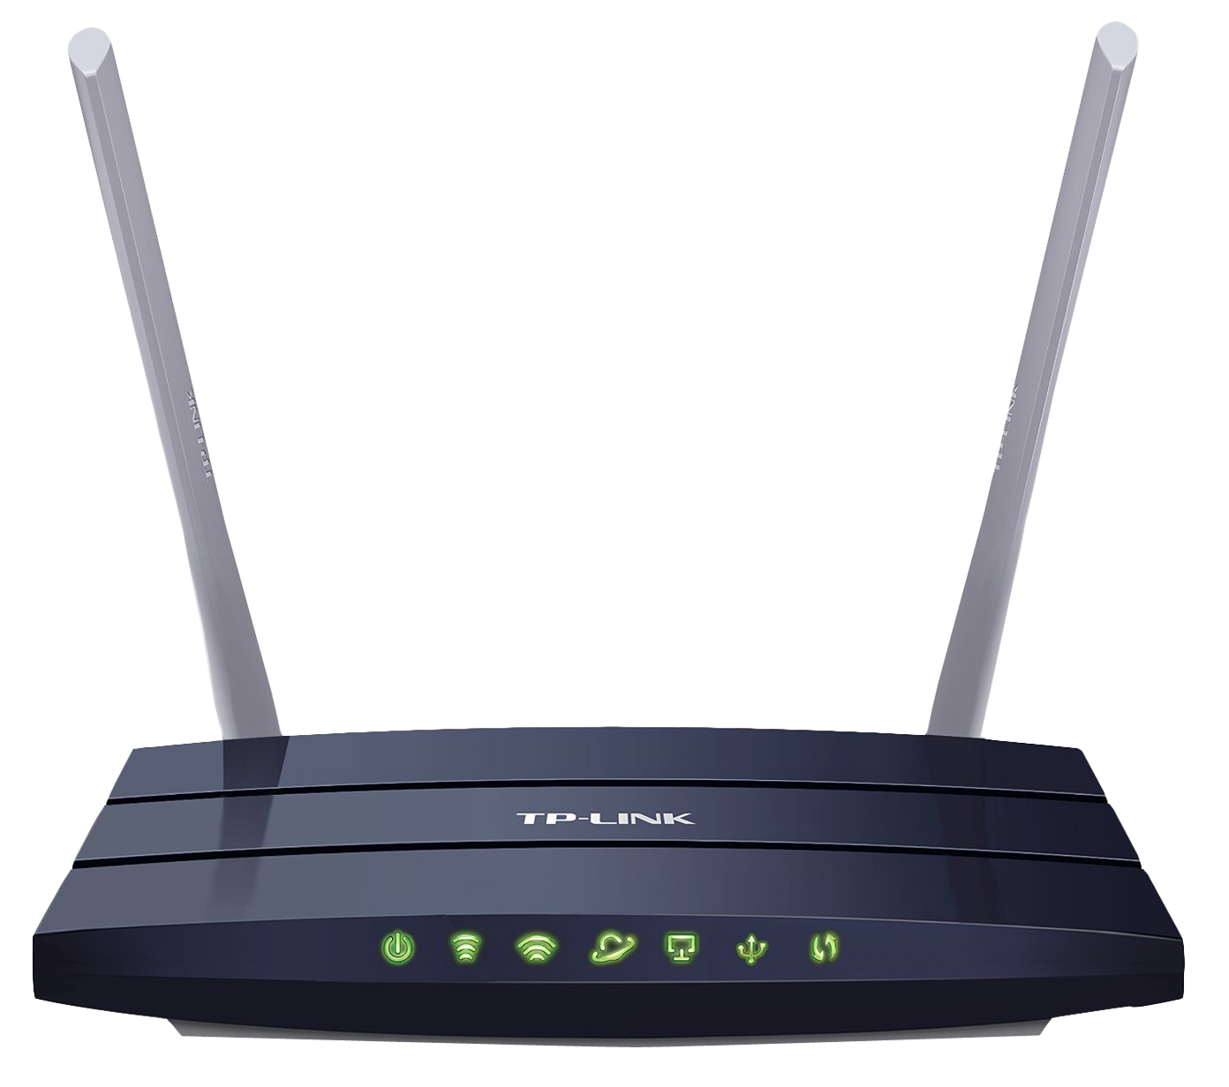
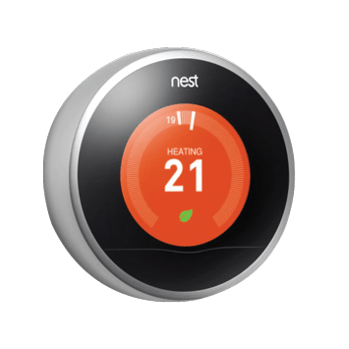
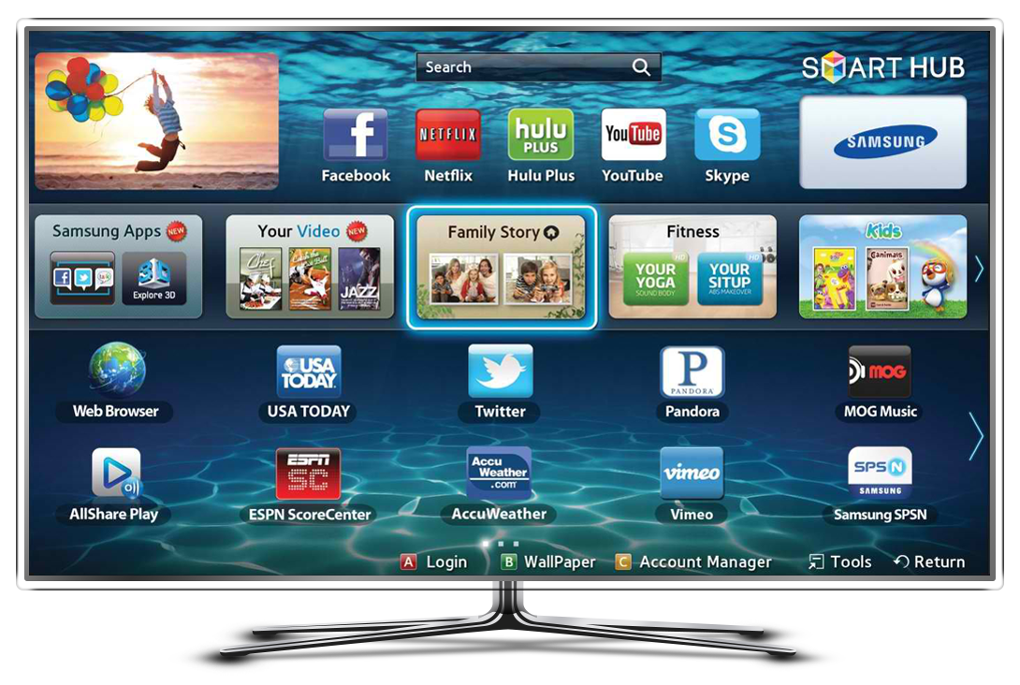
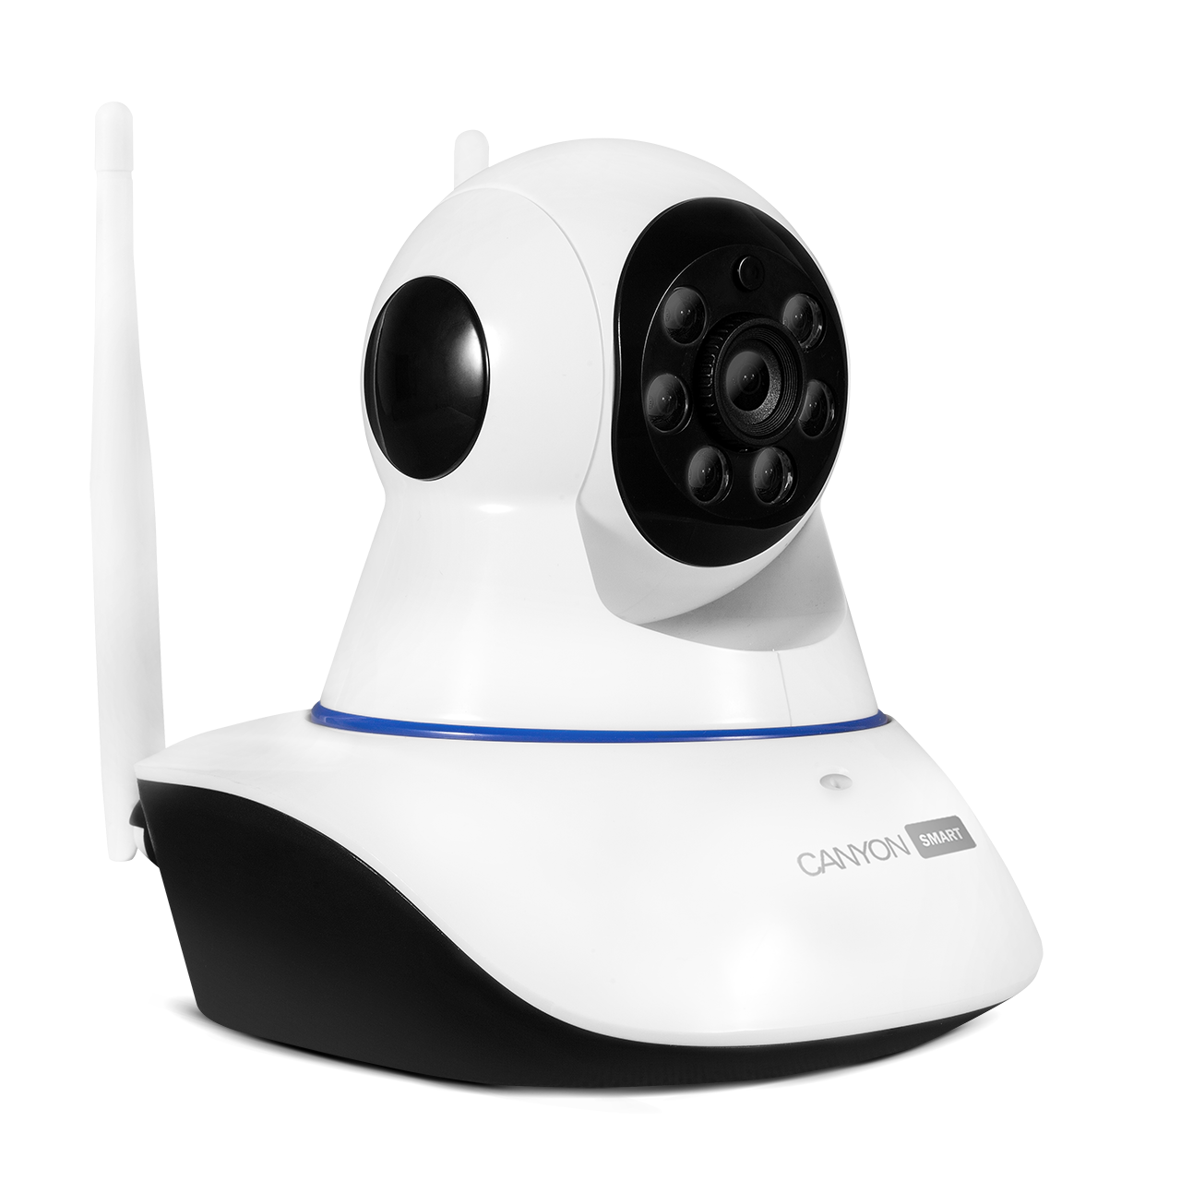
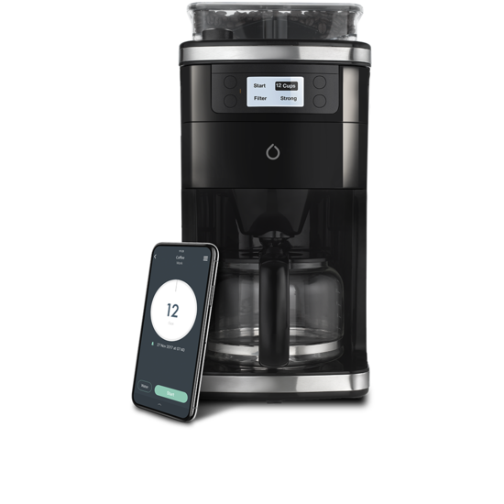
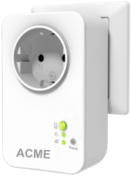
IoT = IoE

Slide 4

IoT = Hardware + OS + app + cloud
wu-ftpd
IIS5.0
RDP
Joomla
RedHat 6.2
Windows
Windows
whatever
HW
HW
HW
HW
app
Busybox
HW

Slide 5
IoT hacking. What to look for
Software
  Telnet (it’s still a thing in 2019. I know…)
  Mobile app – device communication
    Command injection
    Directory traversal / Local file inclusion
    Buffer overflows (99% of all IoTs have binaries compiled without PIE -> no ASLR -> RCE)
  Worth mentioning – A LOT of different vendors share the same code
  Backdoors, credential reuse, private key reuse
  Cloud chatter.
    How does the mobile app talk to the cloud?
    How does the cloud talk to the device?

Slide 6
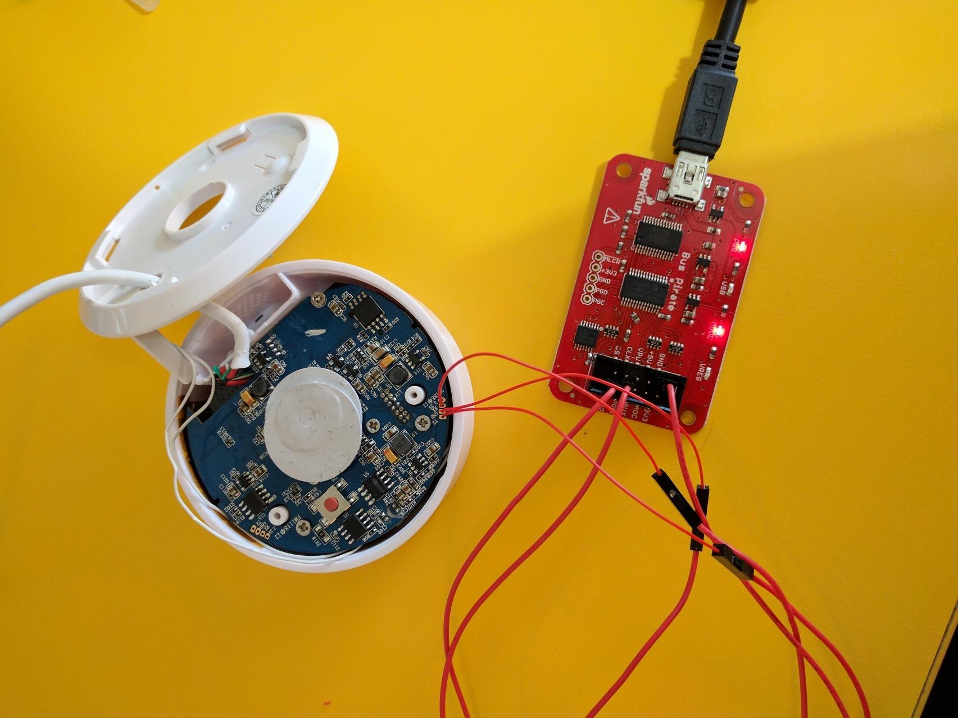
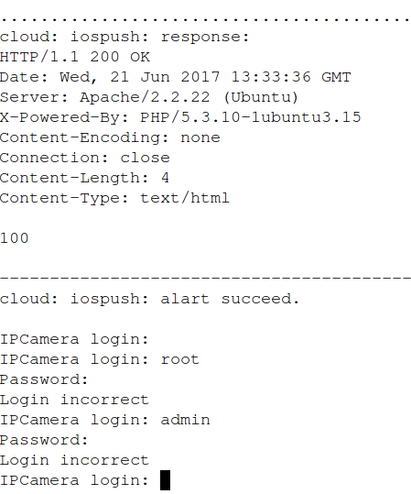
IoT hacking. What to look for
Hardware
  JTAG (ulator)
  Serial interfaces
    Boot hijack

Slide 7
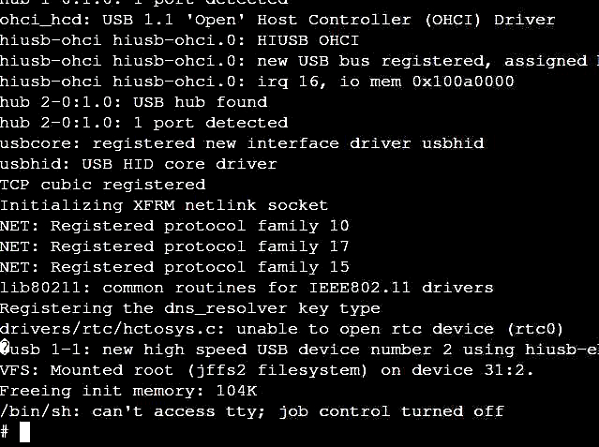
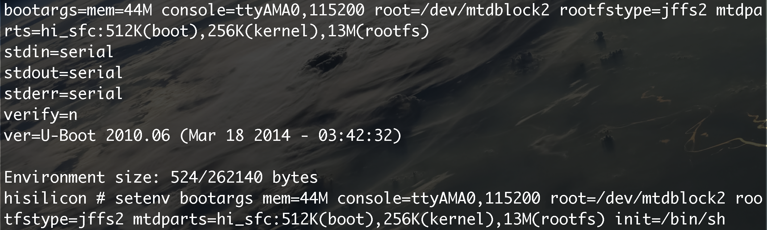
Boot hijack (cont)

Slide 8

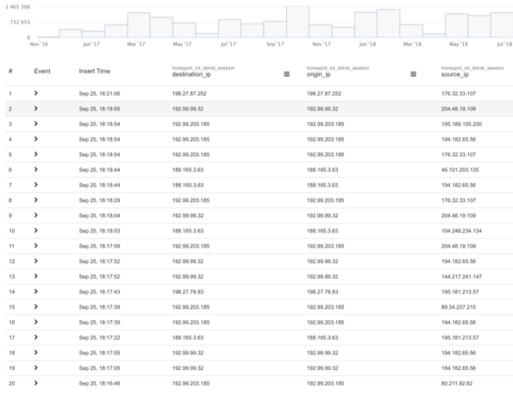
More than 12 botnet families. More than 200 botnets
Mirai, Gafgyt, Hajime, Sina, Objprn, Shishiga, Mr. Black, 84c46036, Reaper, HNS, VPNFilter, BrickerBot
89 botnets based on the MIRAI code alone

Slide 9
Inside the Hide ‘N Seek botnet
First spotted in Feb 2018. Gathered around 45000 victims and died one month later
“rebooted” in April 2018 and remained alive (still kicking today)
P2P
Keeps adding both exploits and capabilities in the dropped agents
Latest addition – ADB in October 2018
Absolutely zero activity other than spreading. Most probable scenario is that it’s used purely for testing

Slide 10
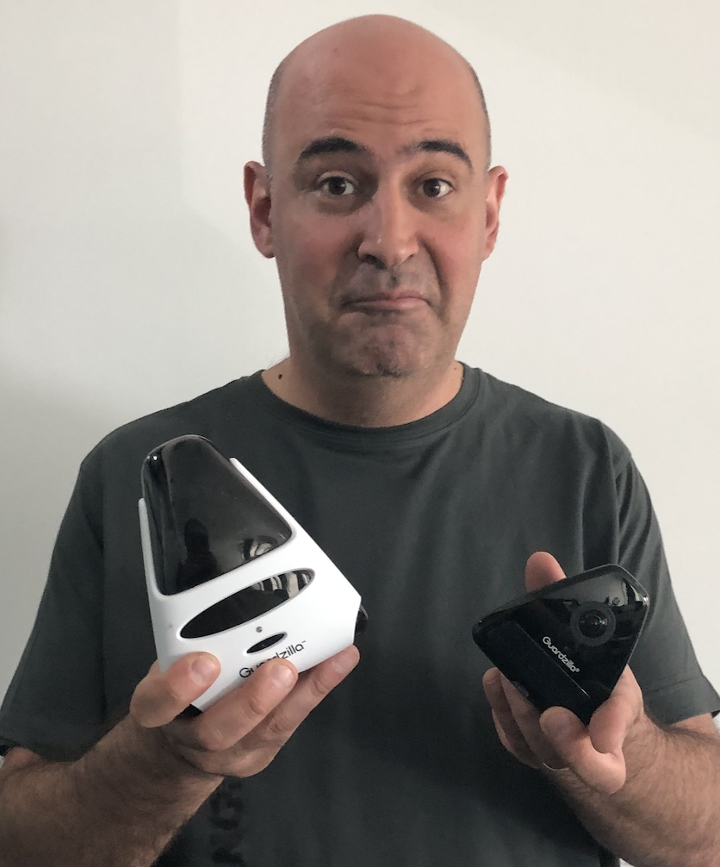
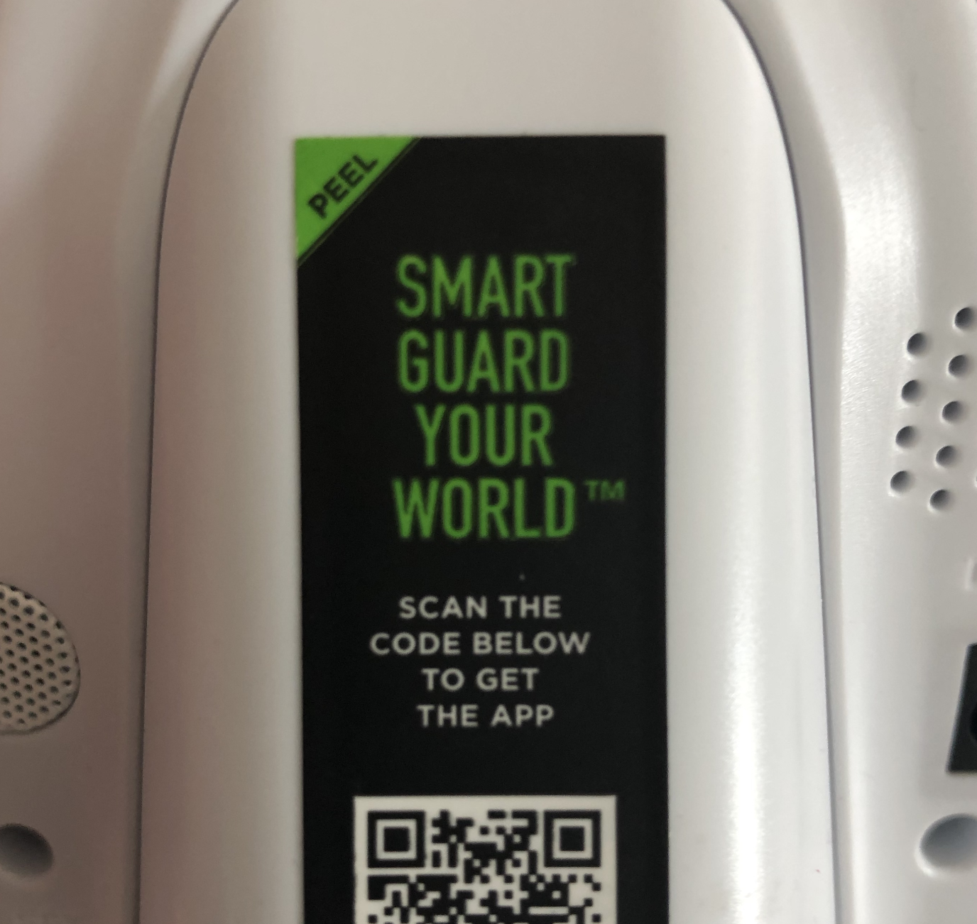
Guardzilla – Smart Security Camera
Enumerate cameras and settings for each account
Access video & audio for each camera
RCE
All with auth bypass
Working on all tested versions

Slide 11
Mobile app behavior
API endpoint at https://apps.guardzilla.com
After the first auth/account registration the app receives a 6 digits long UID (ours is 408311. Have phun!)
  Can’t be changed
  Incremented by 1 for each new account (!!!)

Slide 12

Mobile app behavior
UserID and Password are hardcoded
POST requests sent to the cloud are encrypted with AES256 CBC mode
  Encryption key and IV hardcoded in the app
Did I mention that ”uid” is sequential?

Slide 13
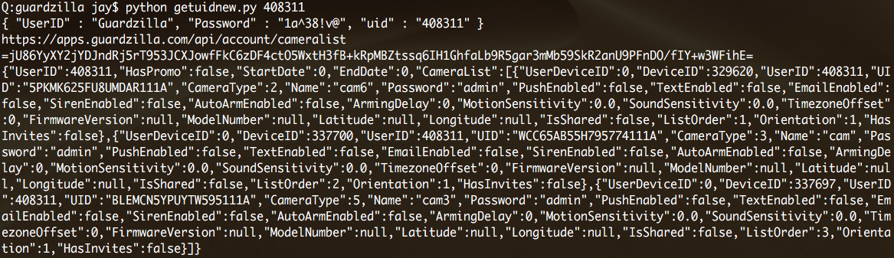
uid+UserID+Password+key+IV=
We only really just need the uid, since all the others are static

Slide 14
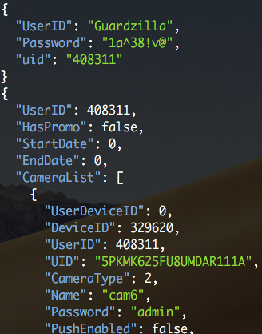
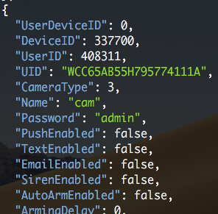
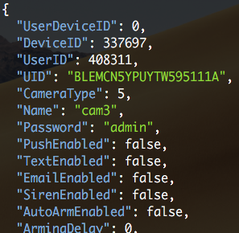
uid+UserID+Password+key+IV=
Useful information: device id (UID) and password

Slide 15
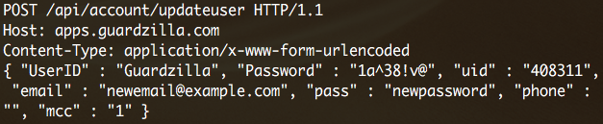
Account takeover
Full account takeover by changing e-mail and pass to arbitrary values
E-mail doesn’t have to be valid since no confirmation e-mail is sent
The old credentials will be invalidated

Slide 16
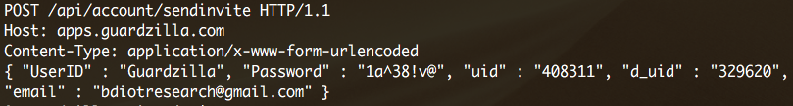
Access to audio/video feed – method 1
“sendinvite” API – requires uid and d_uid (obtained earlier)
Can be used to forge an invitation to view a specific camera
The owner is unaware that somebody else has access to the camera

Slide 17
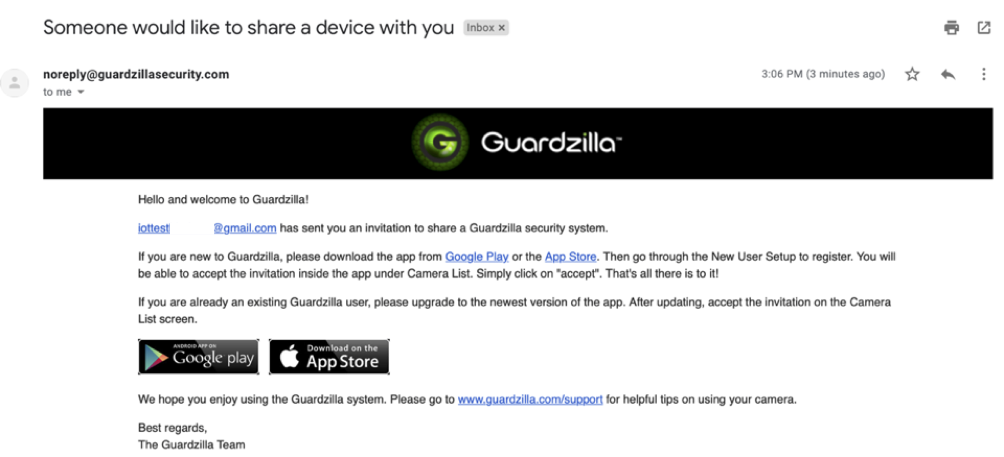
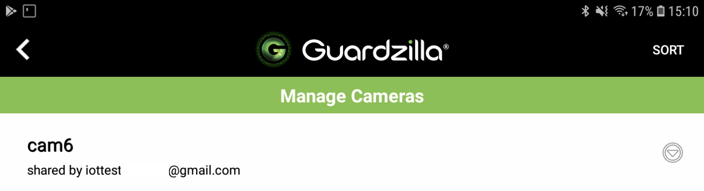

Slide 18
Access to audio/video feed – method 2
Just for the hell of it we wrote a client that emulates the app and pipes the video feed to vlc
Takes device ID and password as parameters

Slide 19
You promised next-gen botnets!

Slide 20
Buffer overflow in the cloud agent
Kalay Platform (https://www.tutk.com/) used for cloud communication
A combination of P2P and relay servers used to bypass NAT restrictions
main.v5.1.4.exe handles a number of services, including cloud communication
Upon inspection, we identified a function vulnerable to out of bound writes: TK_set_deviceModel_req_handle
  A specially crafted buffer sent over the cloud communication gets us RCE

Slide 21
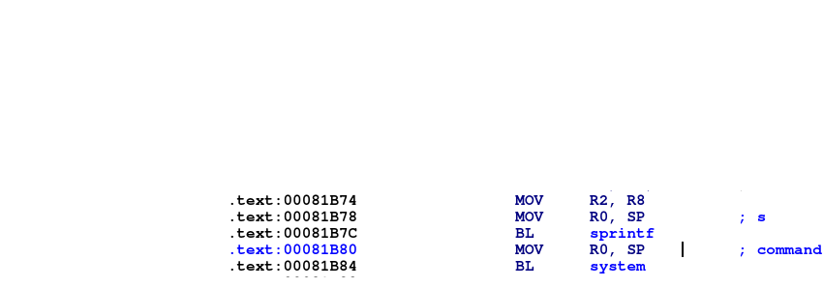
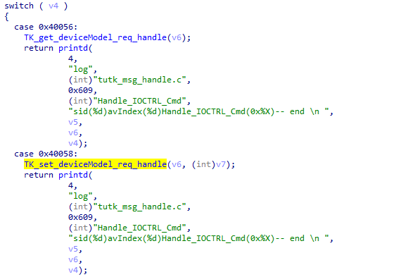
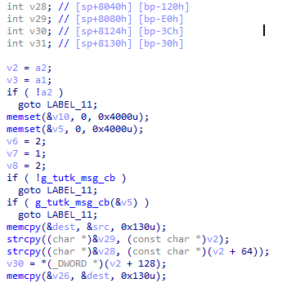
And call system
We overflow v28, then v29 and reach the return address below the stack frame

Slide 22
Calling system. Is anybody home?
The function that sends the command through the cloud
Type of command that corresponds to the TK_set_deviceModel_req_handle function
Gadget address used to call system
The main binary will crash after the command is executed and the camera will restart. To achieve persistence we’ll append the commands to the camera’s startup script @ /mnt/mtd/startapp
Tested against GZ251W, firmware version 0.5.1.4. Other models may be affected

Slide 23
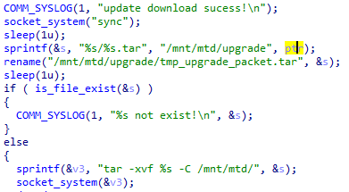
More RCE: command injection

Slide 24
More RCE: command injection
GZ180 supports remote upgrade
The function takes 2 parameters: firmware version and download location
The firmware version will be concatenated to tar as an argument and then executed through the system command
The download location needs to be accessible (not valid)
Camera firmware will remain unaffected since there’s no valid upgrade and its workflow will continue uninterrupted but it won’t accept another upgrade command until reboot
Requires Device UID and password (obtained before)

Slide 25
Bonus AWS bucket access (fixed)
The camera records short videos when the motion detection system is triggered and the camera is armed
Recordings are uploaded to an AWS bucket named motion-detection
One key pair is used for all cameras: AWSAccessKeyId and SecretAccessKey, retrievable from the device firmware
=> full read/write access to the AWS bucket
+ directory index

Slide 26
Takeaways
IoT is a huge attack surface and is growing insanely fast
Leverage cloud communication to bypass NAT
Vendors need to
  Pentest their product periodically. Thoroughly
  Run bug bounty programs
  Have proper and unattended update mechanisms
It’s still trivial to find RCEs in IoT and it seems this won’t change any time soon. More of the security research community needs to focus on this

Slide 27
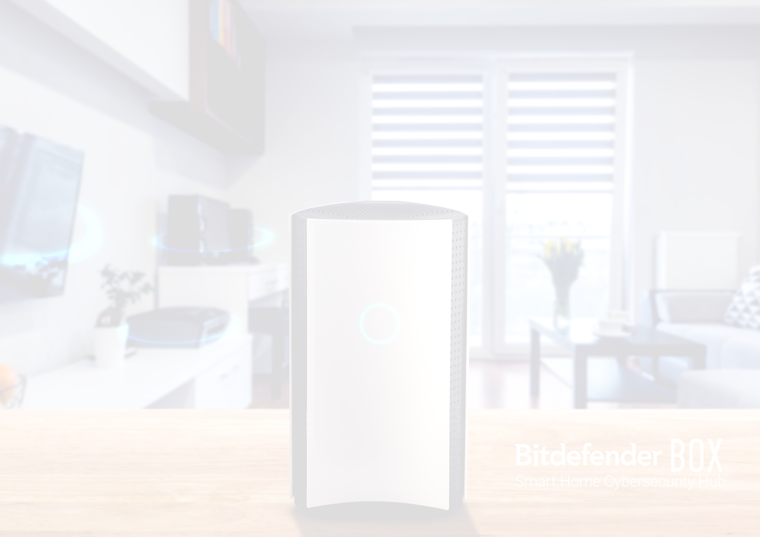
Thank you!
abalan@bitdefender.com | @jaymzu

Slide 28
Notes:
Avatar
You can use this slide when ending a presentation or during Q&A.
It can be even projected before you begin your presentation while the members of the audience arrive and take their seats.
Note: It should only be used when having the Title Slide and Bumper Slides on a black background.

