Slide 1
The Open Lands of the Mediatek Baseband
An explanation why the mediatek baseband is a good attack surface

Slide 2
About Me
About me .
I am Charles Muiruri
Independent security researcher
Interested Reverse Engineering and Vulnerability research
For fun and profit
Twitter : @icrackthecode
Github: https://github.com/icrackthecode
Blog : https://icrackthecode.github.io

Slide 3
Why is the mediatek baseband a good attack surface ?
Kernel | Baseband
ASLR present | No ASLR implementation
Highly audited . | Less audited .
Not a good target when trying to achieve RCE | Perfect for RCE

Slide 4
Setting up a working environment
Open BTS/ OpenBSC -> to implement a gsm network
Software defined Radio hardware .. Eg USRP
A baseband device

Slide 5
Emulating your attack surface
An ideal attack surface in such a case must satisfy the below
    Data handle must be user controlled
    Less user interference
An ideal layer that satisfies the above is layer 3

Slide 6
All the packets are either TV,LV or TLV
RR Management (Radio Resource)
CM Management. (Connection Management
MM Management(Mobility Management)

Slide 7
Radio Resource management (RRM)
Connection Set Up And Release.
Handoff.
Channel Change
Ciphering.

Slide 8
Mobility Management (MM)
TMSI Assignment.
  Identification Process.
  Authentication Process.
  IMSI Detach.
Specific Mobility Management Process
  IMSI Attach
  Location Update

Slide 9
Connection management (CM)
Has 3 entities
Call Control. (Calls)
Supplementary Services. (USSD)
Short Message Services. (SMS)

Slide 10
Reversing the CC entity
Each packets is parsed by a specific handler and most of the IE’s have specific functions basing them
For example:
  A setup peer message is handled by cc_peer_setup_hdlr and its IE’S eg the Bearer Capability (which is a TLV) is parsed by cc_form_app_bc_from_peer

Slide 11
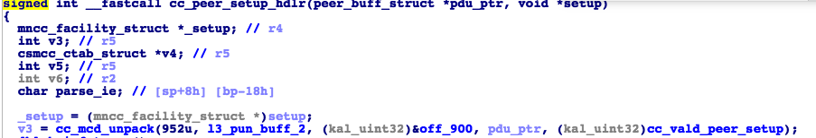

Slide 12
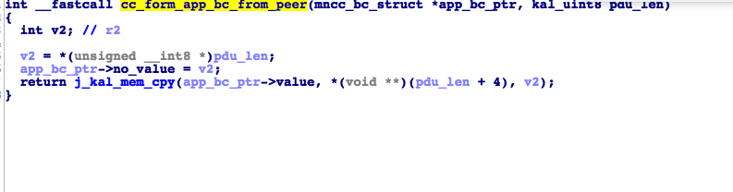

Slide 13
Debugging
This can be simply be achieved by simple hooking techniques.

Slide 14
Thank You

