Slide 1




Observation &
Orientation for
Multi-Domain
Operations with
an Intelligent
Tactical Fog

Slide 2
Multi-Domain Operations
To employ multi-domain capabilities and produce significant and simultaneous challenges for our competitors across all domains:
Maintain a persistent presence
Ensure a cohesive operational perspective
Maximize processing of systems

Slide 3
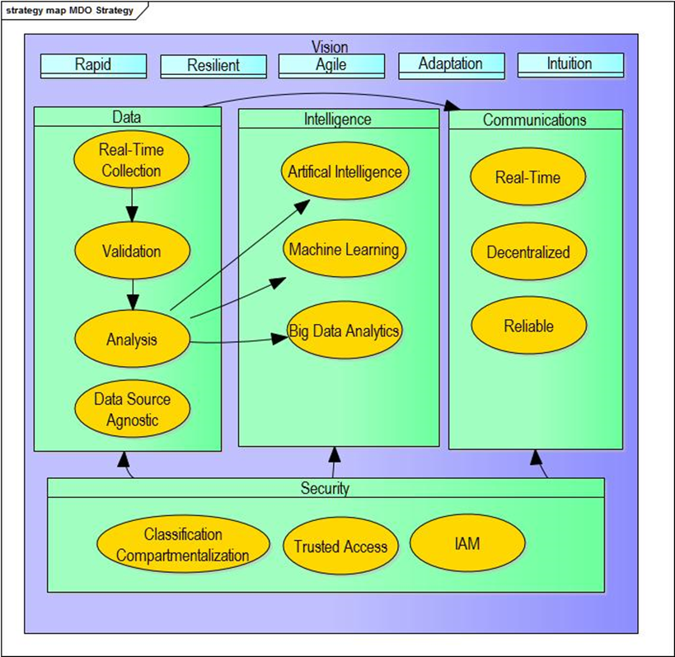
Multi-Domain Operations

Slide 4
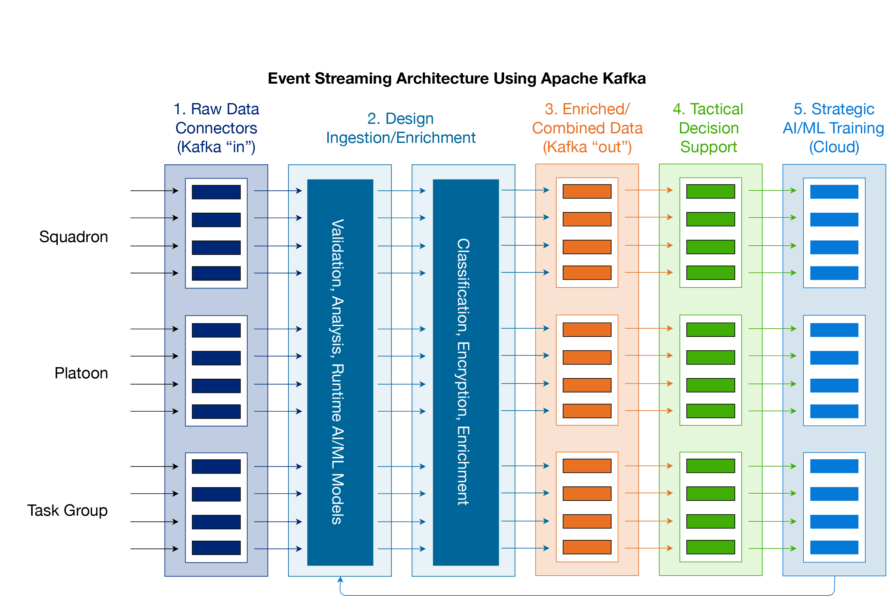
Streaming Architecture with Kafka

Slide 5
What is Fog Computing?
Fog Computing Features Advanced Cloud Technologies:
Containerization
Virtualization
Orchestration
Manageability and efficiency

Slide 6
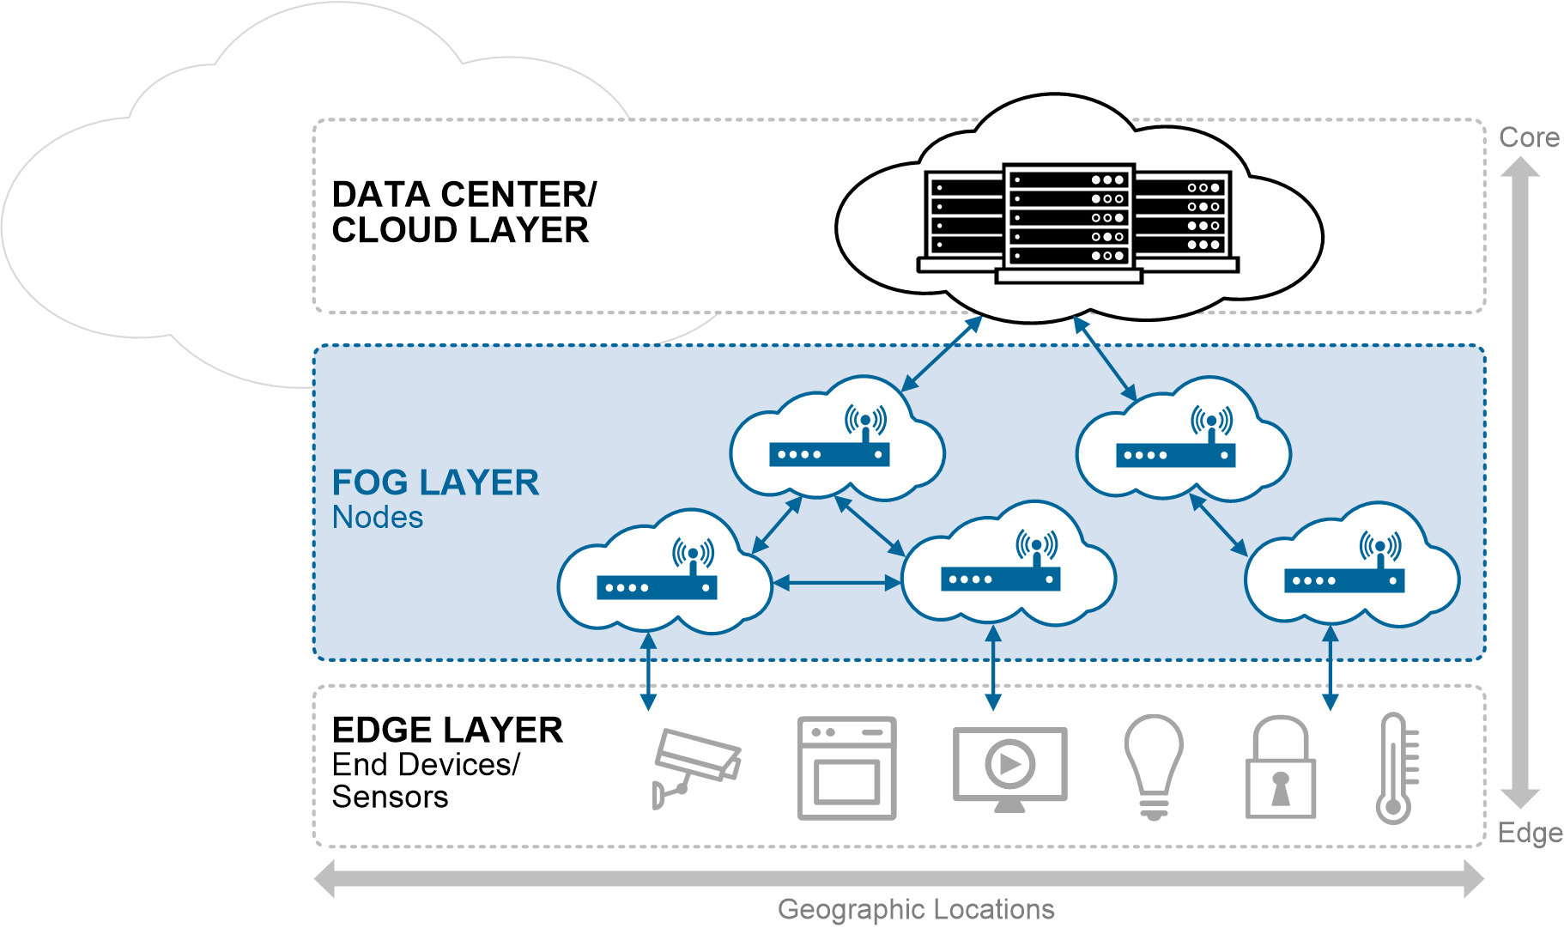
What is Fog Computing?

Slide 7

Why Fog Computing?
OpenFog Reference Architecture advantages:
Security: Additional security to ensure safe, trusted transactions
iiconsortium.org
Cognition: awareness of client-centric objectives to enable autonomy
Agility: rapid innovation & affordable scaling under a common infrastructure
Latency: real-time processing & cyber-physical system control
Efficiency: dynamic pooling of local unused resources from participating end-user devices

Slide 8
Technica SmartFog Platform
The SmartFog prototype platform to bring functions (compute, storage, networking, AI-acceleration, analytics, and management control) closer to the edge—where the IoT devices reside.
Key Benefits:
Events processed in near real-time
Data processed near the edge
Faster results less security risk

Slide 9
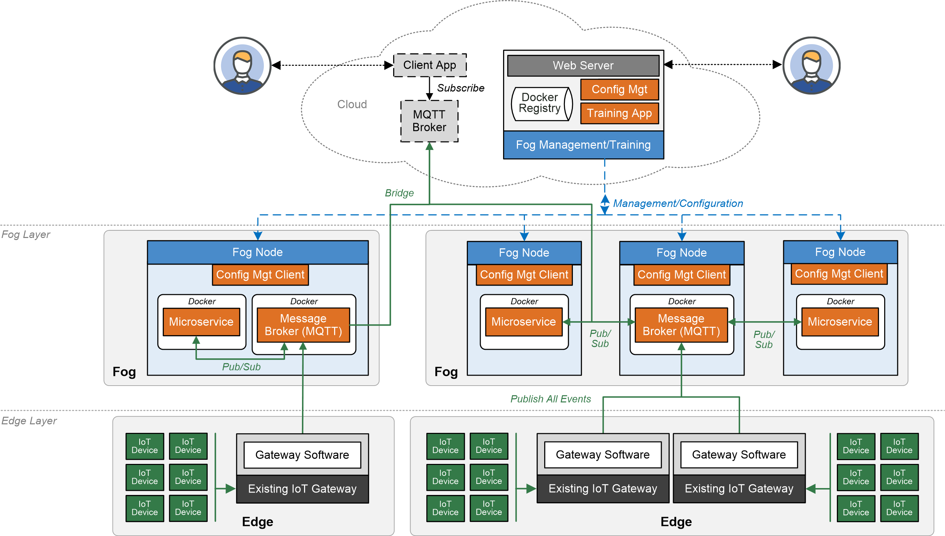
Technica SmartFog Platform

Slide 10
Technica SmartFog Capabilities
Technica has numerous AI & System-level microservices available (or roadmapped) in the SmartFog Catalog that can be leveraged in MDO scenarios including:
Anomaly Detection
Object Recognition/ Classification
DeepFake Creation/ Detection (multi-modal)
Blind Modulation Classification
RF Prioritization
Natural Language Processing/ Translation
Federated Learning
D-DIL Services

Slide 11

Technica SmartFog Platform

Slide 12
Faster OODA Loop & AI Neural Networks
Observe: build a comprehensive picture of the situation with as much accuracy as possible.
Orient: find mismatches: errors in your previous judgement or in the judgement of others.
Decide: having gathered information and oriented ourselves, we must make an informed decision.
Act: execute the decision and then Observe the results.

Slide 13
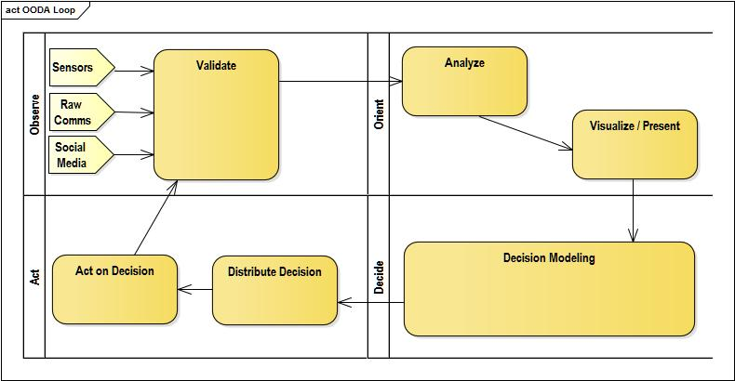
Faster OODA Loop & AI Neural Networks

Slide 14
Federated Learning with SmartFog

Slide 15
Federated Learning with SmartFog

Slide 16

What is Basil?
Blockchain-based, distributed security policy system
Controls other software, systems, or data access
Opensource policy programming language
Attribute based access control (ABAC)
Smart Policies integrate systems with APIs
Gracefully tolerates D-DIL conditions

Slide 17
Basil for MDO
Policy-based information classification
Multi-level data encryption
Hardware configuration security
Development and operations security ("DevSecOps")
System automation
Application security

Slide 18
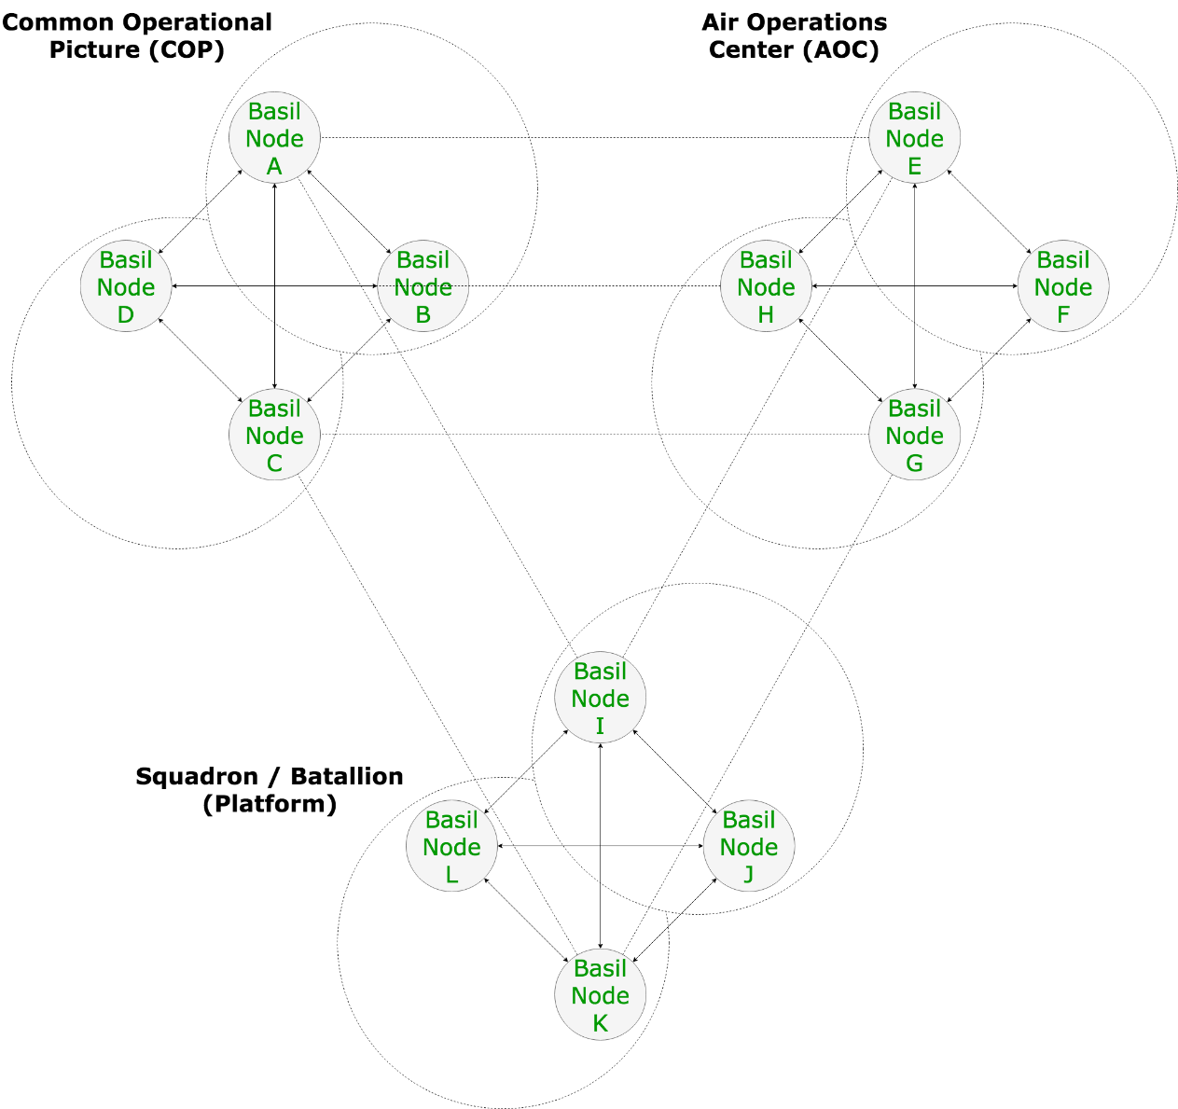
Basil Multi-Domain Node Propagation

Slide 19
Systems of Systems Team Approach
MultiPlex.studio was formed to tackle the AFWERX MDO Challenge by several subject matter experts in enterprise architecture, technical architecture, Multi-Domain Operations and military communications.
Our Systems of System approach is the key to successful implementation and leverages the combined expertise at Multiplex.studio, Technica, and Basil.

Slide 20
Jason Lind
Project Lead
+1 414.788.2820
lind@multiplex.studio
Nick Chadwick
Lead Architect
+1 706.399.0517
chadwick@multiplex.studio
Karl Walinskas
IR&D Business Development
+1 410.303.8104
kwalinskas.ctr@technicacorp.com
Points of Contact for more information
Mitchell Maddox
Project Manager
+1 757.951.3842
maddox@multiplex.studio
Brendon Unland
SmartFog Architect
+1 214.478.4404
bunland@technicacorp.com
Ron Herardian
Security Architect
+1 408.766.4487
ron@basilsecurity.com

